Slide 1
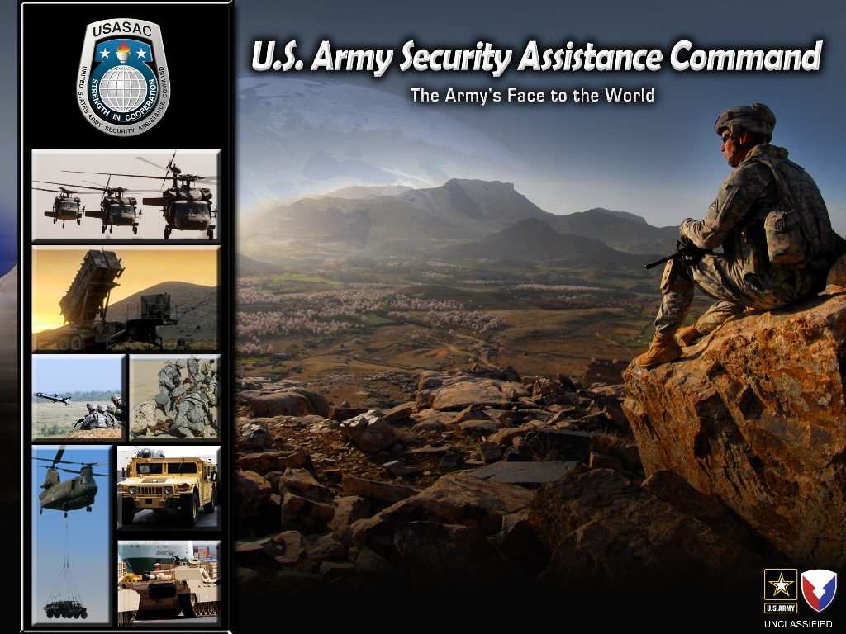
Command Overview
HAMA
10 May 2013

Slide 2
Our Mission - Vision
Mission
USASAC leads the AMC Security Assistance Enterprise. Develops and manages security assistance programs and Foreign Military Sales cases to build partner capacity, support COCOM engagement strategies and strengthen US Global partnerships.
Vision
The Premier Security Assistance Enterprise in the Department of Defense. A highly professional, skilled, and values based workforce that generates trust in advancing U.S. Strategic Partnerships through exceptional security assistance and FMS programs.

Slide 3






DoD Security Assistance Organizations
Defense Finance And Accounting Service
Defense Security Cooperation Agency (DSCA)
Defense Logistics Agency (DLA)
Joint Chiefs of
Staff (JCS)
AIR FORCE
SAF-IA
NAVY
IPO
ASAALT–DASA
For Defense Exports
and Cooperation
(DASA-DEC)
DA G3/5/7
Training and Doctrine Command
(TRADOC)
U.S. Army
Materiel Command
(USAMC)
Combatant Commands
Security Cooperation Offices
Security Assistance Training Field Activity (SATFA)
U.S. Army Security Assistance Command
(USASAC)
Theater Armies / ASCCs
ACC
Acquisition Centers
Command
Life Cycle Management Commands
Security Assistance Management Directorate
Coordination / LOA Tasking
FMS Admin $

Slide 4
USASAC Organization
Small organization… leading a big enterprise
CSM
Commanding
General
OPM SANG
SATMO
Deputy
Performance
Management
Office
Washington
Field Office
Chief of Staff
G1
Command
Information
Office
Human
Resources
Regional Operations
CENTCOM
EUCOM
AFRICOM
PACOM
SOUTHCOM
IMO
AF/PK
G3/5
Special
Staff
Operations,
Security, Strategy
“Face to the World”
USASAC’s focal point is our “country team” … led by our CPMs
Country
Program
Managers
Country
Program
Managers
Country
Program
Managers
Country
Program
Managers
G4
Logistics/
Acquisition
Central
Case
Managers
Central
Case
Managers
Central
Case
Managers
Central
Case
Managers
G6
Information
Management
Small organization… leading a big enterprise
CPM
Forward
CPM
Forward
CPM
Forward
LNO
Forward
“Face to the World”
Regionally aligned
Country-focused
G8
LNO
Forward
CPM
Forward
CPM
Forward
Resource
Management
4

Slide 5
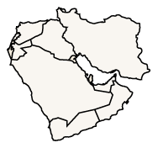
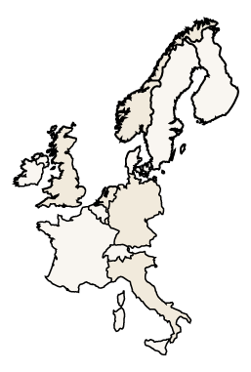
Army Security Assistance Enterprise
Joint Munitions Command-SAMD
Aviation & Missile Life Cycle Management Command-SAMD
TACOM Life Cycle Management
Command-SAMD
PACOM
Liaison
Communications and Electronic
Command -SAMD
U.S. Army Security Assistance Training Management Organization
Program Manager – Saudi Arabia National Guard
CENTCOM
Liaison
USASAC:
  Redstone Arsenal
  New Cumberland
  Fort Bragg
  Fort Belvoir
  Saudi Arabia
Deputy Assistant Secretary of the Army for Defense Exports and Cooperation (DASA-DEC)
Training and Doctrine Command
(TRADOC)
Security Assistance Management
Directorate (SAMD)
PEO-STRI
SOUTHCOM
Liaison
R2TF Liaison
EUCOM
Liaison
AFRICOM
Liaison
Afghanistan Liaisons
CSTC-A & ASE-A

Slide 6


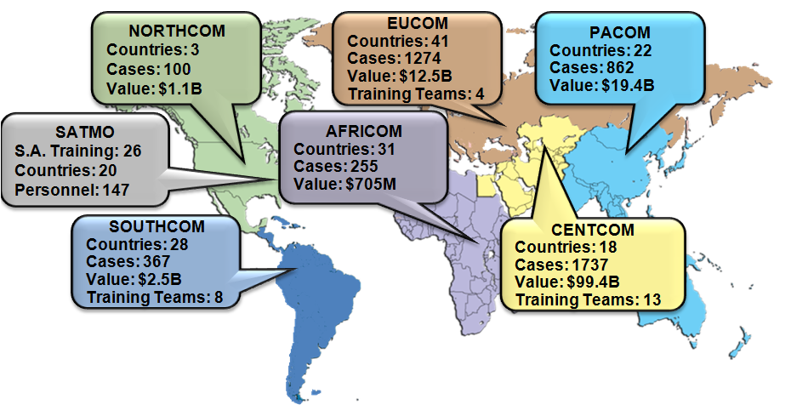
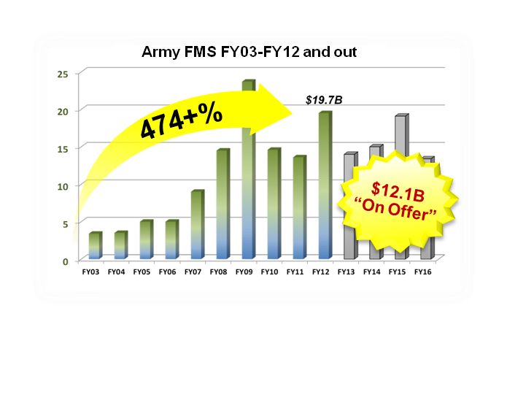
Army Security Assistance Global Engagements
Win…Army
Win…Industry
Win…143 Partner Nations
The Army’s Face to
The World!
Executing SA programs in
support of NSS and P-S-W
1206/1207 programs
supporting counterterrorism
and stability operations in
20 Countries ~ $209M FY12.
NDAA extends through FY14.
Excess Defense Articles
(EDA) as a tool to divest,
support depots and build
partner relationships
Strategic Initiatives
Support to Regionally Aligned Forces
Special Defense Acquisition Fund
Special Defense Repair Fund
Total Active FMS
Countries: 143
Cases: 4635
Value: $135.6B
Undelivered: $57.1B
FY12: $19.7B
Benefits of Security Assistance
Strategic engagements FY12
- Key Leader Engagements – 49
- Program Reviews – 240 per month
- Foreign Students Trained – 11.5K
- SA Teams OCONUS – 40
Engaging with Allies while Building Partner Capacity
PREVENT
WIN
USASAC
Supporting Army Readiness Decisions
SHAPE
UNCLASSIFIED//FOUO
9

Slide 7

USASATMO OPERATIONS FOOTPRINT
COCOM COUNTRIES with ACTIVE TEAMS
CENTCOM | 8
EUCOM | 4
SOUTHCOM | 8
NORTHCOM | 0
PACOM | 0
AFRICOM | 0
TEAM LOCATIONS (Teams / Personnel)
CENTCOM | EUCOM
Afghanistan | Estonia
Egypt | Georgia
Kuwait | Sweden
Lebanon | Kosovo
Saudi Arabia
UAE
Iraq
Jordan
SOUTHCOM | SOUTHCOM CONT
Colombia | Belize
Dominican Rep
Ecuador
Nicaragua | AFRICOM
Panama
Peru
Guatemala
Current : Projected:
SATMO OPERATIONS
20 of 146 Countries with Active Teams
26 Active Teams
147 Personnel

Slide 8

Army Security Assistance Enterprise
Department
of State
Congress
~ USASAC ~
The Army’s Face
to the World
Industry
ASA-ALT
Department
of Commerce
DA STAFF
DSCA DISAM
AMC
DTSA
NSA
NGA
PEO / PM FMS
SDDC
TRANSCOM
DASA-DEC
USAMMA
sco
sco
Joint Project Office (JPO)
sco
USASAC
TACOM SAMD/IMMC
sco
COCOM
ASCCs
DASA(DEC)
USASAC
DCMA
JMC
SAMD/IMMC
Other MILDEPs
sco
DLA
GSA
DCAA
AMCOM SAMD/IMMC
ACC
CECOM SAMD / LRC
TRADOC
STRI
COE
Collaborative Enterprise
Notes:
5/9/2013
8

Slide 9



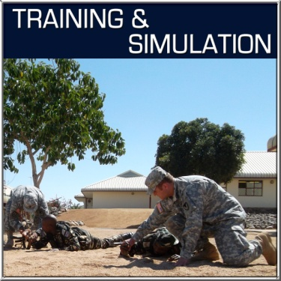
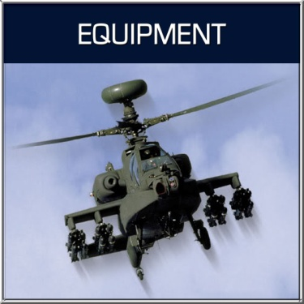
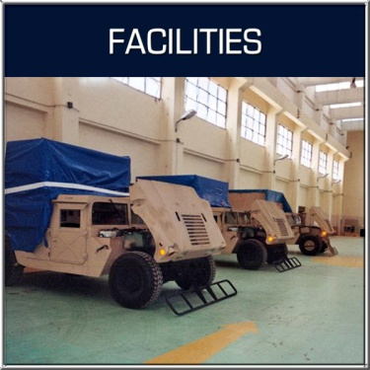
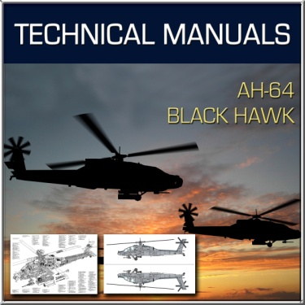
Total Package Approach / Case Responsibilities
Country Program
(CPM)
CASE 2
CASE 3
CASE 5
CASE 6
CASE 4
CASE XX
Platform (PM)
AH-64D Case (SAMD)
CPMs ….
A cadre of knowledgeable, proactive, well-trained,
well-equipped, diplomatic,
leader / professionals.

Slide 10
The FMS Process
PRE-LOR (Ph I)
CASE DEVELOPMENT (Ph II)
CASE EXECUTION
PH III)
CASE CLOSURE
(Ph IV)
DSCA CWD
COUNTRY
USASAC
COUNTRY
RFI
OTHER AGENCIES
(Review /
Add Notations)
(Accept
Delivery)
(Supply Complete
Reconcile Records
Financial Reconciliation
Closure Certificate)
(Waivers &
Congressional
Notifications)
LOR
USASAC
LCMC / SAMD
DFAS
SCO
Launch Contract
Actions
(Final Billing
to Customer)
(Receipt of RFI)
LCMC / SAMD
SCO
DFAS
(LOA to Country)
COUNTRY
(Confirms
Closure)
COUNTRY
DFAS
USASAC
USASAC
(CPM Prepare
Response)
(LOA Accepted)
(Implement
Case)
(Execute Level I Response)
Time: Indeterminate (based off a defined actionable request)
Time: 120 days from LOR complete
Time: Indeterminate (from off the shelf items to contracting and production items)
Time: Goal is within 2 years of supply complete (incl. warranty)
SCO: Security Cooperation Office
DSCA: Defense Security Cooperation Agency
CWD: Case Writing Division
DFAS: Defense Finance and Accounting Services
LOR/LOA: Letter of Request/Acceptance
SAMD: Security Assistance Management Division
RFI: Request For Information
CPM: Country Program Manager

Slide 11
EDA Transfer Process
COUNTRY LETTER OF REQUEST (LOR)
LCMC: Life Cycle Management Center
PM: Program Manager
JVI: Joint Visual Inspection
FMS: Foreign Military Sales
Determine Excess Materiel Availability
LCMC PMs / G-8
4-6 MONTHS
USASAC PREPARES / STAFF
TRANSFER MSG TO
DASA-DE&C (COORDINATES WITH ARSTAF)
DSCA / STATE
APPROVE TRANSFER
CONGRESSIONAL
NOTIFICATION
Up to 30 days
Defense, Commerce, State
G3/5/7,G4,G8
4-8 MONTHS
CPM INFORM
COUNTRY
(LOR JVI)
REFUSED
at JVI
LCMCs final Disposition
JOINT VISUAL
INSPECTIONS
2-4 MONTHS
FMS CASE
PREPARATION / OFFER
DSCA COUNTER
SIGNATURE AND
COUNTRY ACCEPTANCE
FMS CASE
IMPLEMENTED
COORDINATE
TRANSPORTATION
FOR SHIPMENT OF
MATERIEL TO THE
COUNTRY
Country has up to 60 days for acceptance

Slide 12
FMS Organic Base Workloads
EDA Delivered (Quantity)
FY | Cases | Track Vehicles | Tactical Wheel Vehicles | Other / Class VII (O/VII) | Ammo
FY09 | 17 | 0 | 325 | 29 | 0
FY10 | 42 | 115 | 310 | 0 | 100,000
FY11 | 13 | 1,325 | 0 | 120 | 186,339
FY12 | 12 | 184 | 381 | 16 | 1,064,193
TOTAL | 84 | 1,624 | 1,016 | 165 | 1,350,532
Inquiries for FY13+ EDA
Country | Item
A | AMCOM Items ( HAWK equipment)
B | CECOM Items (NVDs, Radios Optics, Laser Range Finders, NVDs) AMCOM Items (UAVs, Rocket Launcher) TACOM Items ( Mortar, Howitzer, Robots) AMCOM Items (TOW Missiles)
C | TACOM Items (M923's or M927‘s)
D | TACOM Items (M198, 155mm ) available as a Long Supply)
E | TACOM Items (M109A6s)
F | TACOM Items (HMMWVs)
EDA Cost Avoidance Examples
M113 FOV storage and demilitarization = 5,370 available X $30,900 ea. = $166M
M1A1 storage and demilitarization = 600 for Morocco/Greece X $85,900 ea. = $51M
FMS Refurb Workload (Organic Base)
Period | Quantity | Items | Work Years
FY 10-12 Firm | 1364 | M1A2S, M1A1 AIM,M113, M198, M88 | 1029
FY 13-16 High Potential | 580 | M1A2S, M1A1 AIM, M113, M198, M88 | 922
Period Unknown | 750 | M1A1 AIM, M109, M113 | 375
TOTAL | 2694 |  | 2326
FMS Repair and Return (R&R) (Work Years)
 | Corpus Christi Army Depot Aviation/Weapons | Letterkenny Army Depot Missile/TWV | Tobyhanna Army Depot Aviation/Missile | Sierra Army Depot Prep & Ship EDA | Red River Army Depot TWV | Total
FY11 | 16.6 | 15.2 | .02 | 5.8 | N/A | 37. 62
FY12 | 13.0 | 44.5 | 0 | 5.6 | 1.7 | 64.8
EDA= Cost Avoidance + Organic Based Workload

Slide 13






Army Security Assistance Enterprise
DASA-DEC
USASAC
LCMCs
  ACC
  PEOs
COCOMs
We’re all about:
- Promises
Process
People

Slide 14
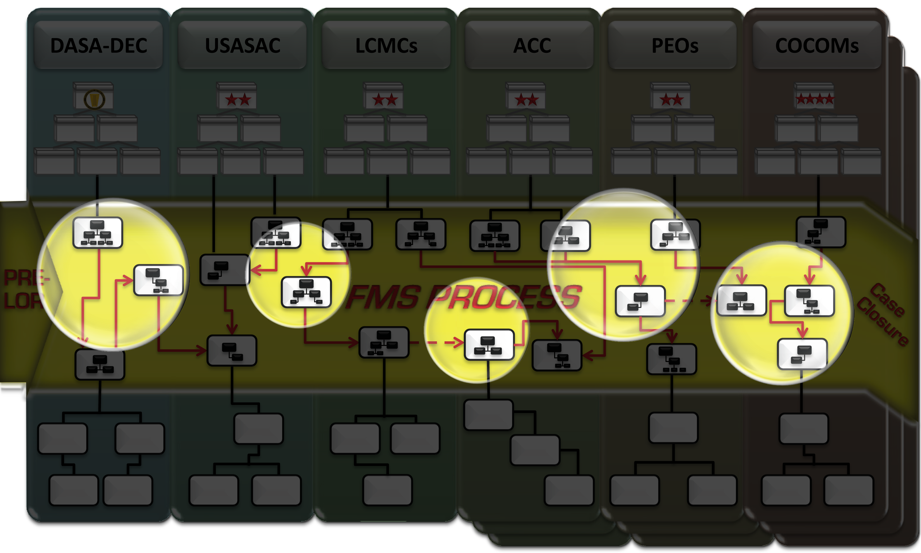



Army Security Assistance Enterprise
ENTERPRISE ROLES / MISSION (DA PAM 12-1)
Common Operational Picture (COP)
and Senior Leader Enterprise Dashboard (SLED)
Improved Visibility of Contracting Milestones
Increased Visibility of Transportation Data
MORE PROACTIVE FMS CASE MANAGEMENT
Enterprise Training (DSR-T)

Slide 15




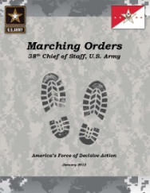
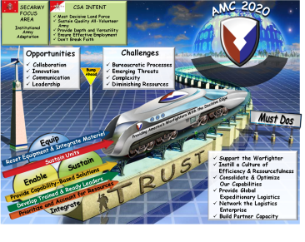


Security Assistance Strategic Roadmap
ARMY P-S-W STRATEGY
Effective SA
Programs
Supporting
NSS
AMC VISION 2020
Must Dos
• PREVENT: The Army prevents conflict by maintaining credibility based on capacity, readiness and modernization. It averts miscalculations by potential adversaries.
• SHAPE: The Army shapes the environment by sustaining strong relationships with other Armies, building their capacity, and facilitating strategic access.
• WIN: If prevention fails, the Army rapidly applies its combined arms capabilities to dominate the environment and win decisively.
Support the Warfighter
Instill a Culture of Efficiency & Resourcefulness
Consolidate & Optimize our Capabilities
Provide Global Expeditionary Logistics
Network the Logistics Enterprise
Build Partner Capability
Resource the
Enterprise
Train the Enterprise
Lead the Enterprise
See the Enterprise
FOCUSING ON THE FUTURE
Support to Warfight
Maintain … Support to New NSS and P-S-W
EDRB Management of Warfight
Dynamic Management of Global FMS Program
Acquisition and Delivery of Systems
… + Sustainment … + Training
Separated Process
Improved Integration with AMC as LMI
BRAC Aftermath
HQs / Enterprise “Reset”
Essential Component of Prevent - Shape - Win

Slide 16
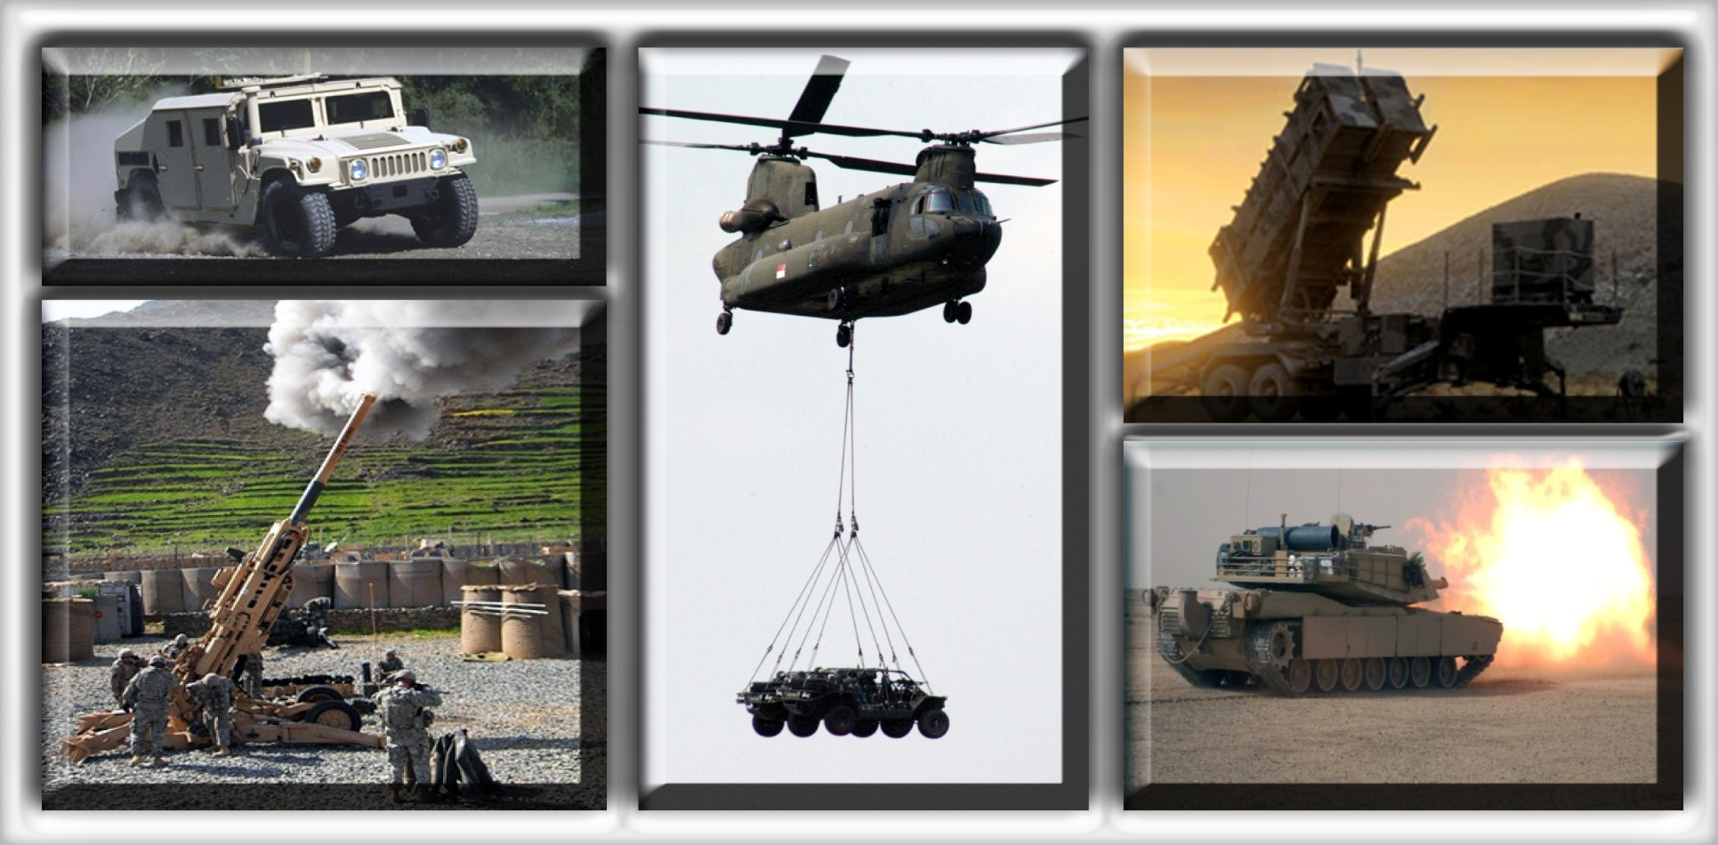
Strength in Cooperation

